Slide 1




Better Together: Text + Context
Kenneth W. Church,* John E. Ortega,*
Maria Antoniak,** Sergey Feldman** and Hui Guan***
*Northeastern University, **Allen Institute for Artificial Intelligence and ***Umass

Slide 2
Meta Issues: (Important for the future of JSALT)
Diversity:
Better Together: Text proposals + Speech proposals
Deliverables:
Basic tasks + Stretch tasks
Evaluation
Better benchmarks
Resources: more embeddings
Tools: APIs for routing papers, recommendations
Theory: Unified Framework of Deep nets & SVD
work with conference organizers

Slide 3
New Stuff (since yesterday)
New team member: Hui Guan
Contribution from new team member:
GNNs with parallelism during training
Evaluation (and related downstream evaluations)

Slide 4
Team

Slide 5
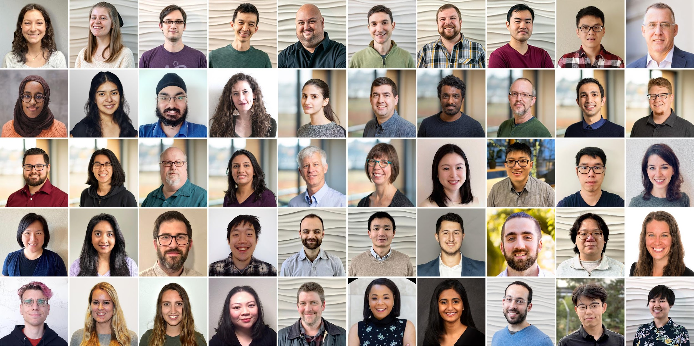
Semantic Scholar: Significant Effort (slide from Dan Weld)
50 person team
7 year project
207M+ scientific paper index
8M+ monthly active users

Slide 6
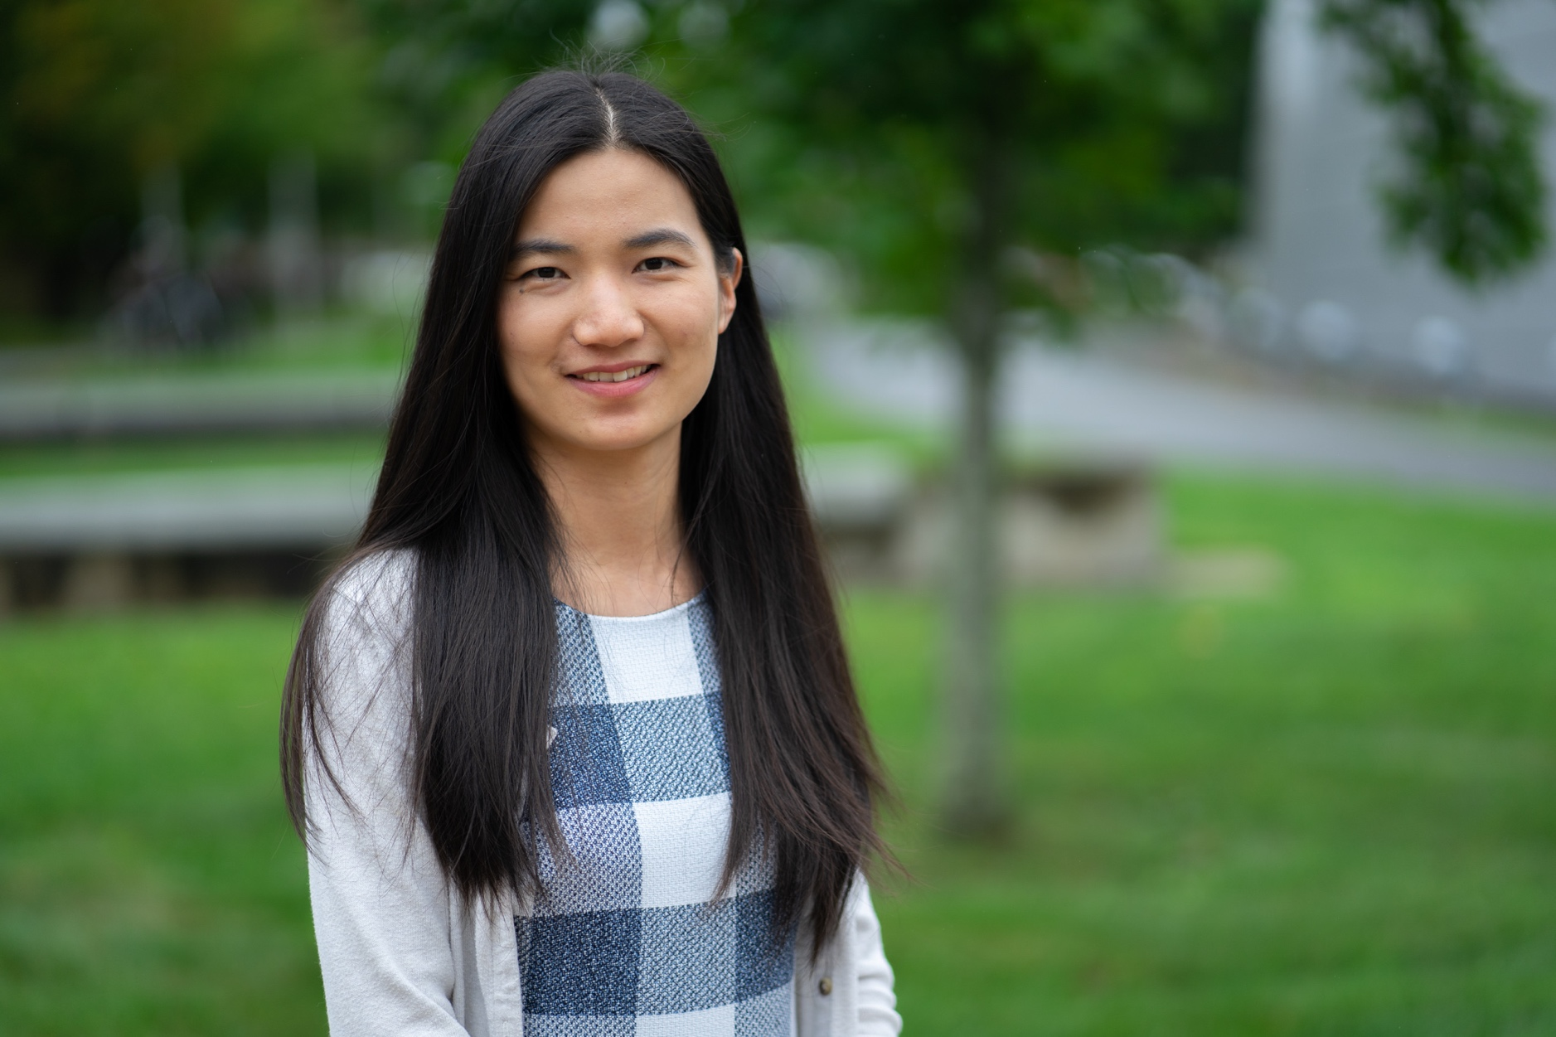
Hui Guan - Bio
Assistant Professor, Computer Science, UMass Amherst
Expertise:
Systems for Machine Learning
Multi-Task Learning
Graph Machine Learning
Website: https://guanh01.github.io/
[OSR’21] Scalable Graph Neural Network Training: The Case for Sampling.
[NeurIPS’2022] AutoMTL: A Programming Framework for Automating Efficient Multi-Task Learning.
[PLDI’19] Wootz: a Compiler-based Framework for Fast CNN Pruning via Composability

Slide 7

Teaser: Goals for Recommender System
Recommender Systems
Relevance (on topic)
Importance (highly cited)
Do not return papers that are
Buzz word compliant
But not credible
(most papers are not cited)
Paper routing for conferences
Submissions → reviewers
Conjectures:
Iffy software
Automatic assignments are worse than manual assignments
Reviewers are less qualified and less sympathetic to background
than target audience
Better assignments → better conferences

Slide 9
Scale: Smaller than Web (but challenging for academia)
Papers (millions) | 8 Bits | Sources
79.18 | 11000000 | CorpusId, MAG
68.37 | 11100000 | CorpusId, MAG, DOI
19.69 | 11110000 | CorpusId, MAG, DOI, PubMed
12.05 | 10100000 | CorpusId, DOI
5.66 | 10000000 | CorpusId
5.10 | 11010000 | CorpusId, MAG, PubMed
4.11 | 11101000 | CorpusId, MAG, DOI, DBLP
2.99 | 11110100 | CorpusId, MAG,DOI, PubMed, PubMedCentral
2.96 | 10010000 | CorpusId, PubMed
7.69 | other
207.80 | totals
 | Source | Papers (millions)
1 | CorpusId | 207.80
2 | MAG (Microsoft Academic Graph) | 182.18
3 | DOI | 113.54
4 | PubMed | 35.03
5 | DBLP | 6.06
6 | PubMedCentral | 4.86
7 | ArXiv | 2.15
8 | ACL | 0.08
 | totals | 551.71

Slide 10
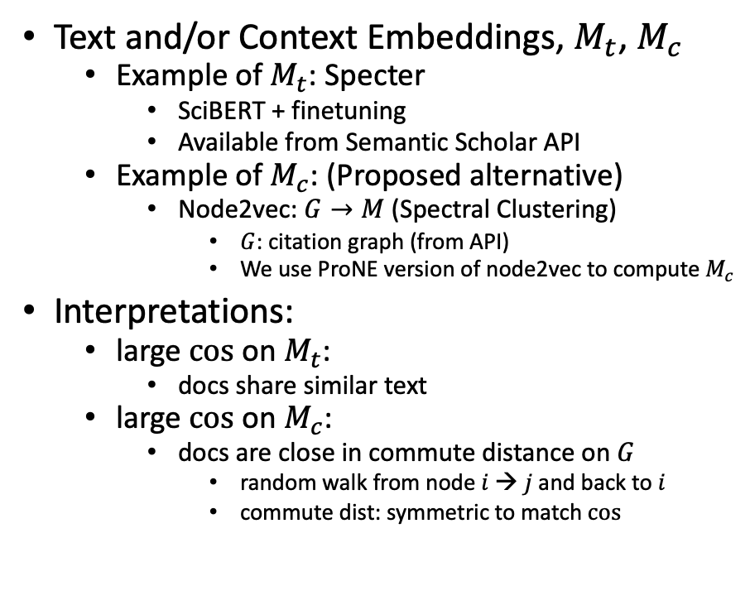
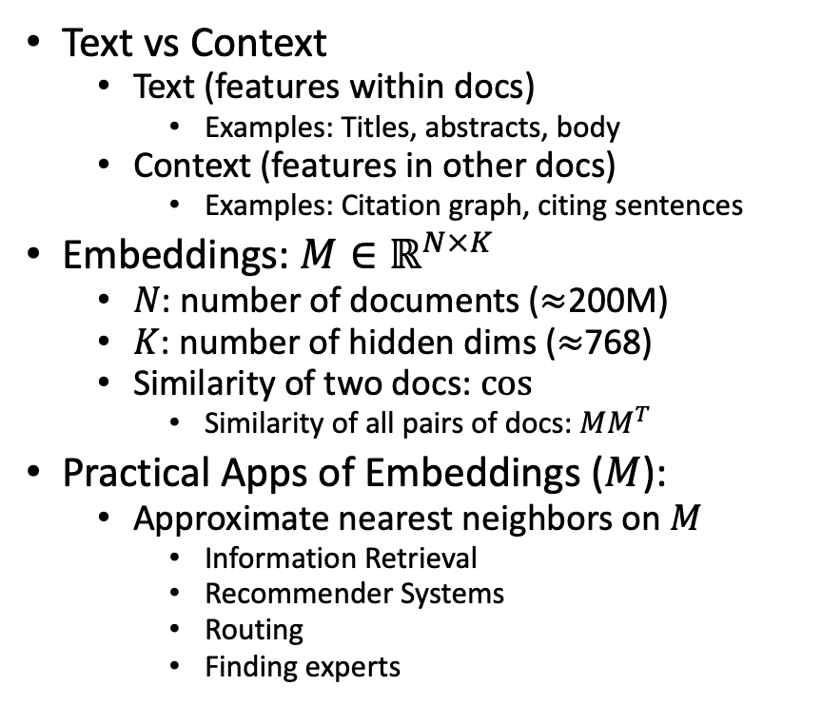
Proposal: Build Multiple Embeddings to Capture Text and/or Context
Text vs Context
Text (features within docs)
Examples: Titles, abstracts, body
Context (features in other docs)
Examples: Citation graph, citing sentences
Embeddings: $M∈ℝ^{N×K}$
$N$: number of documents ($≈$200M)
$K$: number of hidden dims ($≈$768)
Similarity of two docs: $cos⁡$
Similarity of all pairs of docs: $MM^{T}$
Practical Apps of Embeddings ($M$):
Approximate nearest neighbors on $M$
Information Retrieval
Recommender Systems
Routing
Finding experts
Text and/or Context Embeddings, $M_{t}$, $M_{c}$
Example of $M_{t}$: Specter
SciBERT + finetuning
Available from Semantic Scholar API
Example of $M_{c}$: (Proposed alternative)
Node2vec: $G→M$ (Spectral Clustering)
$G$: citation graph (from API)
We use ProNE version of node2vec to compute $M_{c}$
Interpretations:
large $cos$ on $M_{t}$:
docs share similar text
large $cos$ on $M_{c}$:
docs are close in commute distance on $G$
random walk from node $i$→ $j$ and back to $i$
commute dist: symmetric to match $cos$
old
Latent Semantic Indexing
new
Currently, not in Semantic Scholar

Slide 11
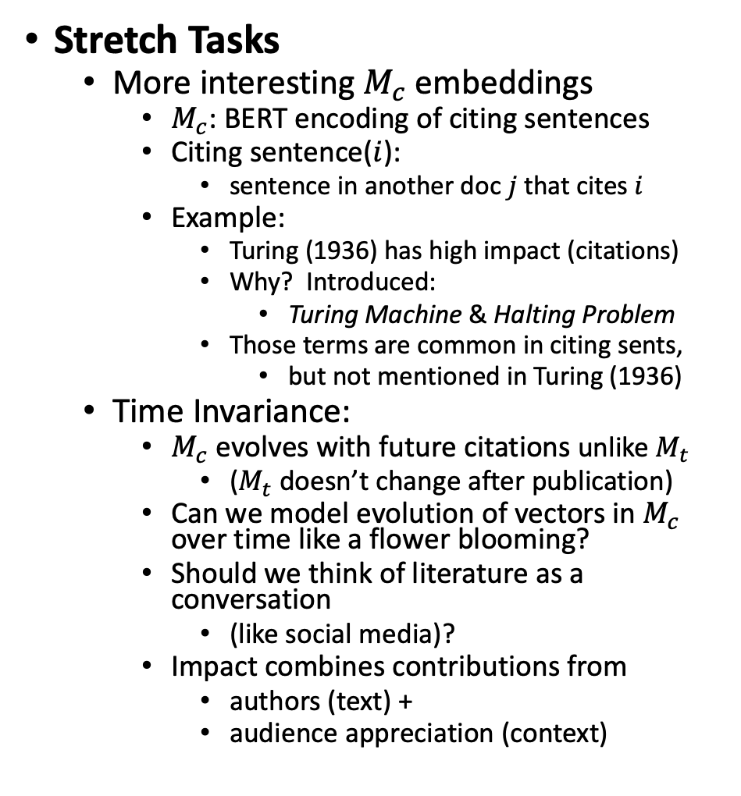
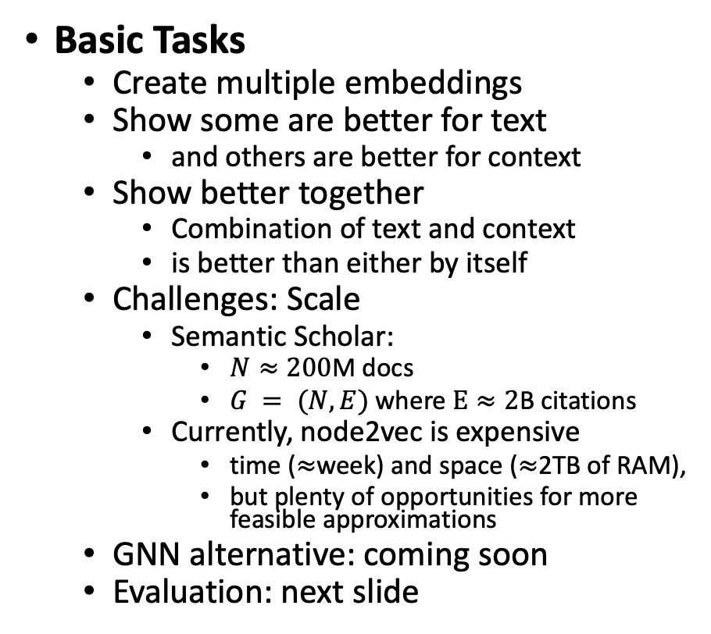
Basic & Stretch Tasks
Stretch Tasks
More interesting $M_{c}$embeddings
$M_{c}$: BERT encoding of citing sentences
Citing sentence($i$):
sentence in another doc $j$that cites $i$
Example:
Turing (1936) has high impact (citations)
Why? Introduced:
Turing Machine & Halting Problem
Those terms are common in citing sents,
but not mentioned in Turing (1936)
Time Invariance:
$M_{c}$ evolves with future citations unlike $M_{t}$
($M_{t}$doesn’t change after publication)
Can we model evolution of vectors in $M_{c}$ over time like a flower blooming?
Should we think of literature as a conversation
(like social media)?
Impact combines contributions from
authors (text) +
audience appreciation (context)
Basic Tasks
Create multiple embeddings
Show some are better for text
and others are better for context
Show better together
Combination of text and context
is better than either by itself
Challenges: Scale
Semantic Scholar:
$N≈200$M docs
$G = (N, E)$where $E≈2$B citations
Currently, node2vec is expensive
time ($≈$week) and space ($≈$2TB of RAM),
but plenty of opportunities for more feasible approximations
GNN alternative: coming soon
Evaluation: next slide
Anchor Text
Current status
(K=280)

Slide 12
New Stuff (since yesterday)
New team member: Hui Guan
Contribution from new team member:
GNNs with parallelism during training
Evaluation (and related downstream evaluations)

Slide 13
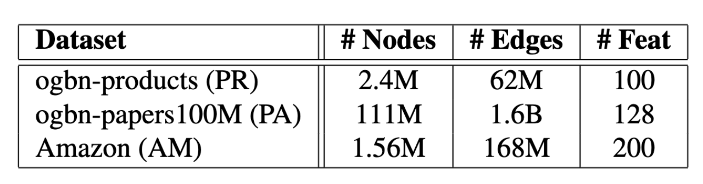
Evaluation
MAG240M
Established Benchmarks (⚠️)
https://mimno.infosci.cornell.edu/data/nips_reviewer_data.tar.gz
https://github.com/allenai/scidocs
“Related” downstream tasks (⚠️ ⚠️ ⚠️)
MAG240M https://arxiv.org/pdf/2103.09430.pdf
Create a new Benchmark
Work with conference organizers (Bhuvana Ramabhadran)
Predict held out citations
Remove some edges from citation graph
See how well you can predict the held out edges
(This method can also be used to train embeddings)
Most Relevant
Specter

Slide 14
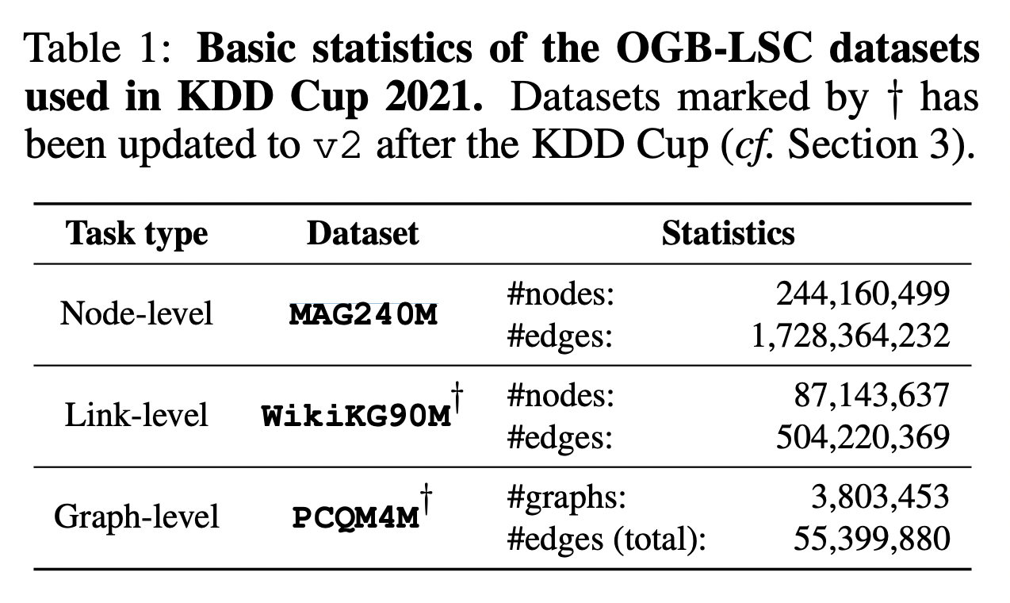
“Related” Downstream Evaluations (from https://arxiv.org/pdf/2103.09430.pdf)
 | Source | Papers (millions)
1 | CorpusId | 207.80
2 | MAG (Microsoft Academic Graph) | 182.18
3 | DOI | 113.54
4 | PubMed | 35.03
5 | DBLP | 6.06
6 | PubMedCentral | 4.86
7 | ArXiv | 2.15
8 | ACL | 0.08
⚠️ ⚠️ ⚠️ ⚠️ ⚠️ ⚠️ ⚠️ ⚠️ ⚠️ ⚠️ ⚠️ ⚠️

Slide 15
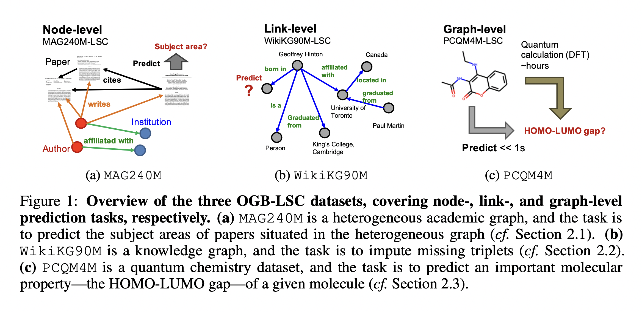
“Related” but not quite the same as our problem

Slide 16
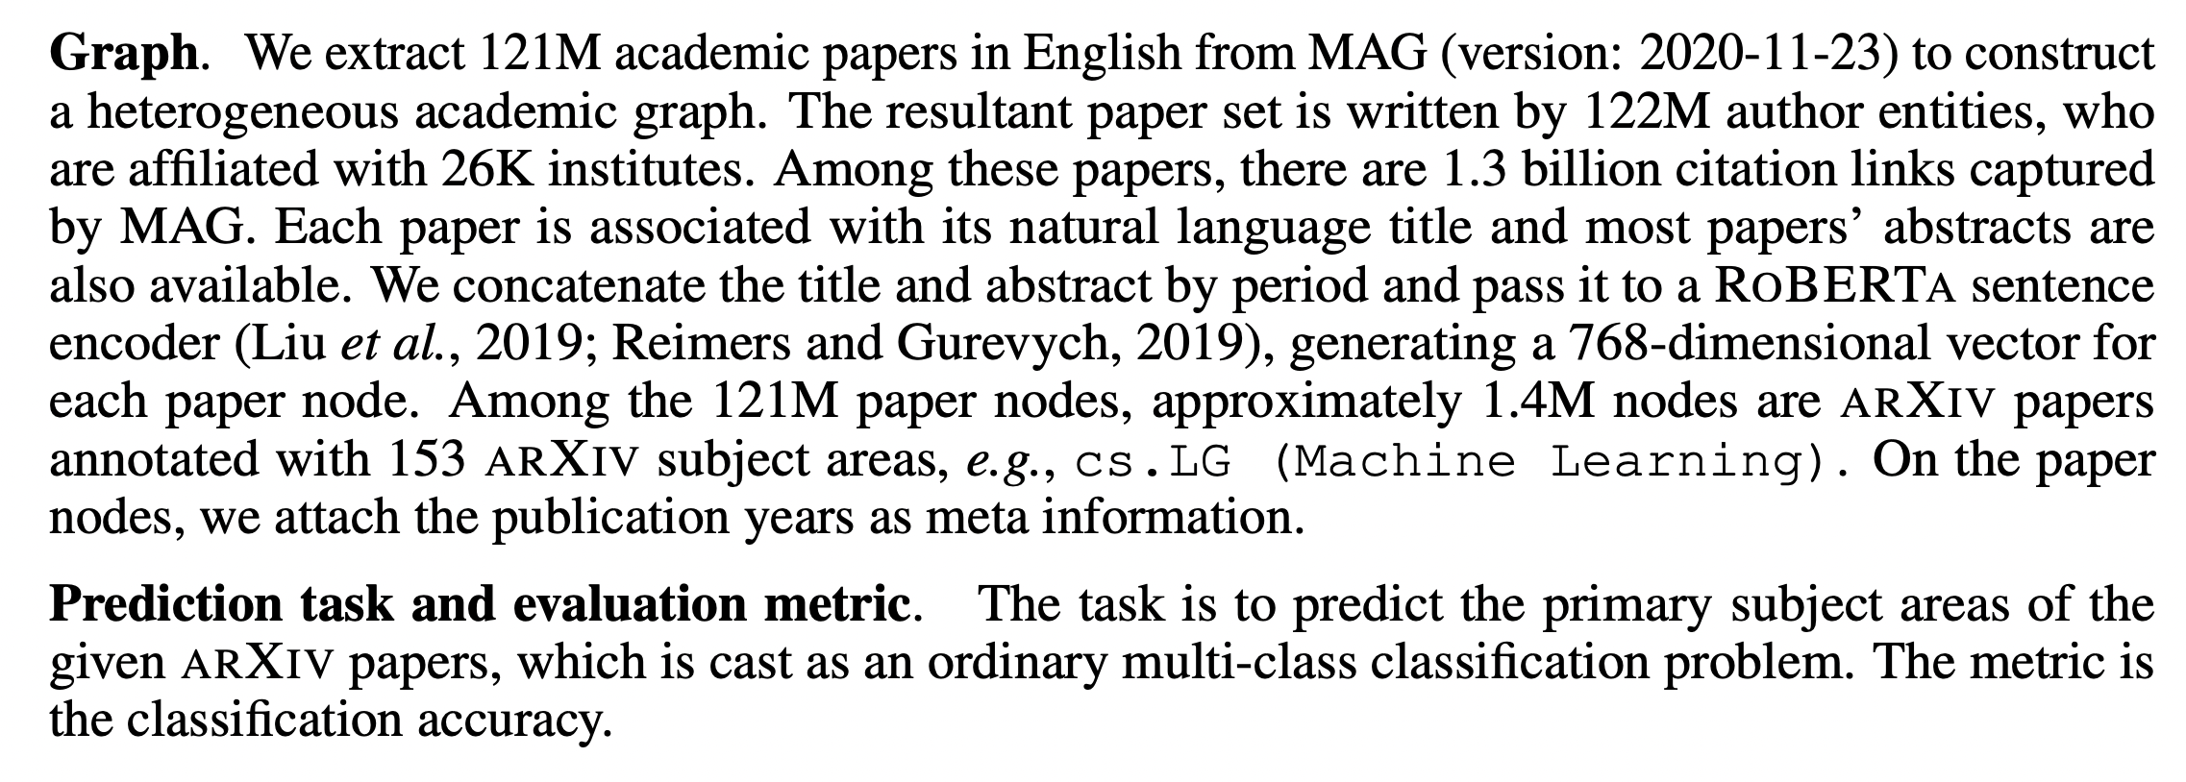
Related Task: predict subject areas Our Task: est similarity of two docs
 | Source | Papers (millions)
1 | CorpusId | 207.80
2 | MAG (Microsoft Academic Graph) | 182.18
3 | DOI | 113.54
4 | PubMed | 35.03
5 | DBLP | 6.06
6 | PubMedCentral | 4.86
7 | ArXiv | 2.15
8 | ACL | 0.08
Text Embedding

Slide 17
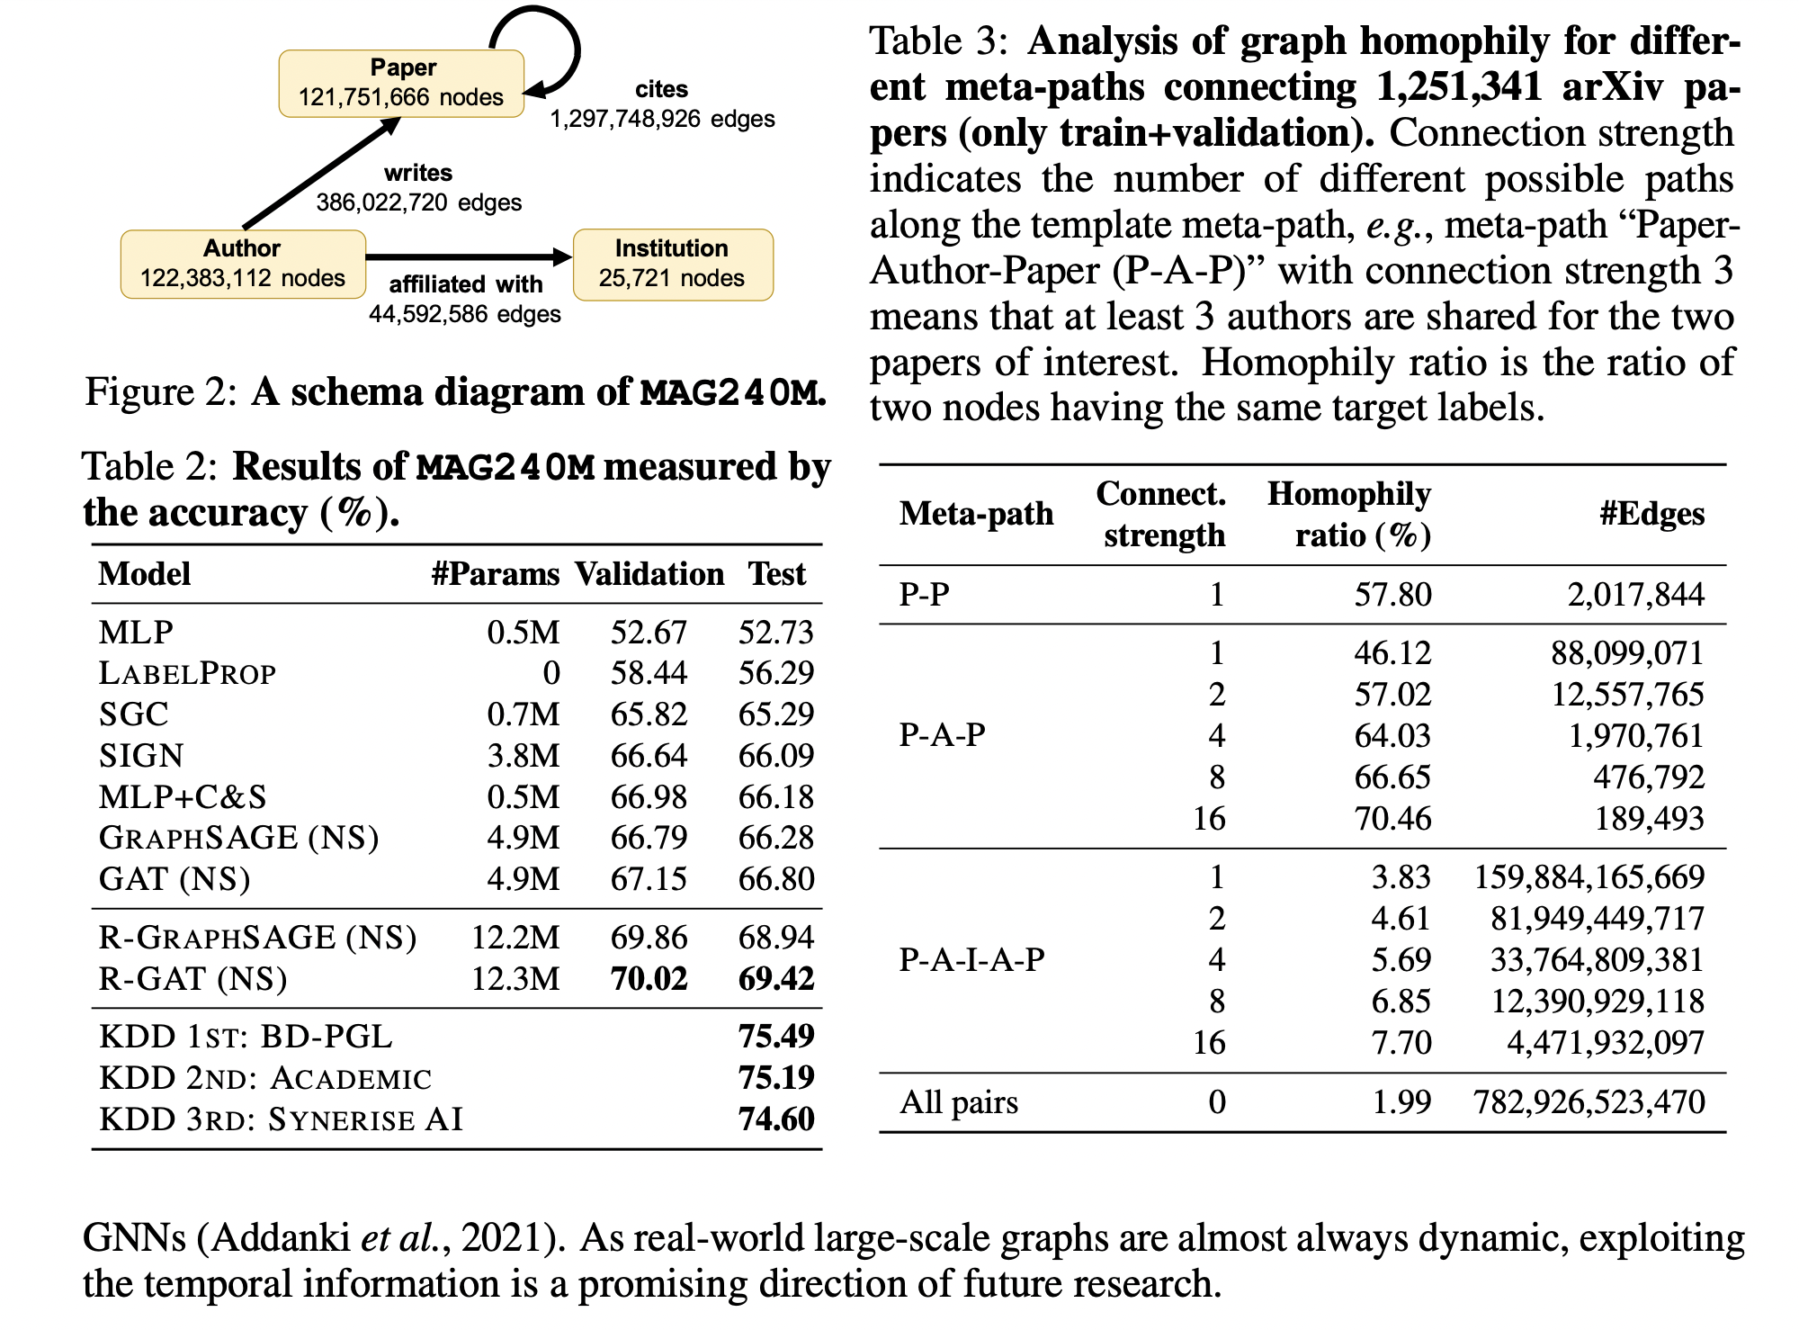

Slide 18
New Stuff (since yesterday)
New team member: Hui Guan
Contribution from new team member:
GNNs with parallelism during training
Evaluation (and related downstream evaluations)

Slide 19

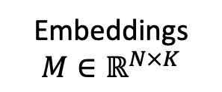
GNN Alternative
Black Box
GNN
Embeddings
$$M∈ℝ^{N×K}$$
Text
Context

Slide 20
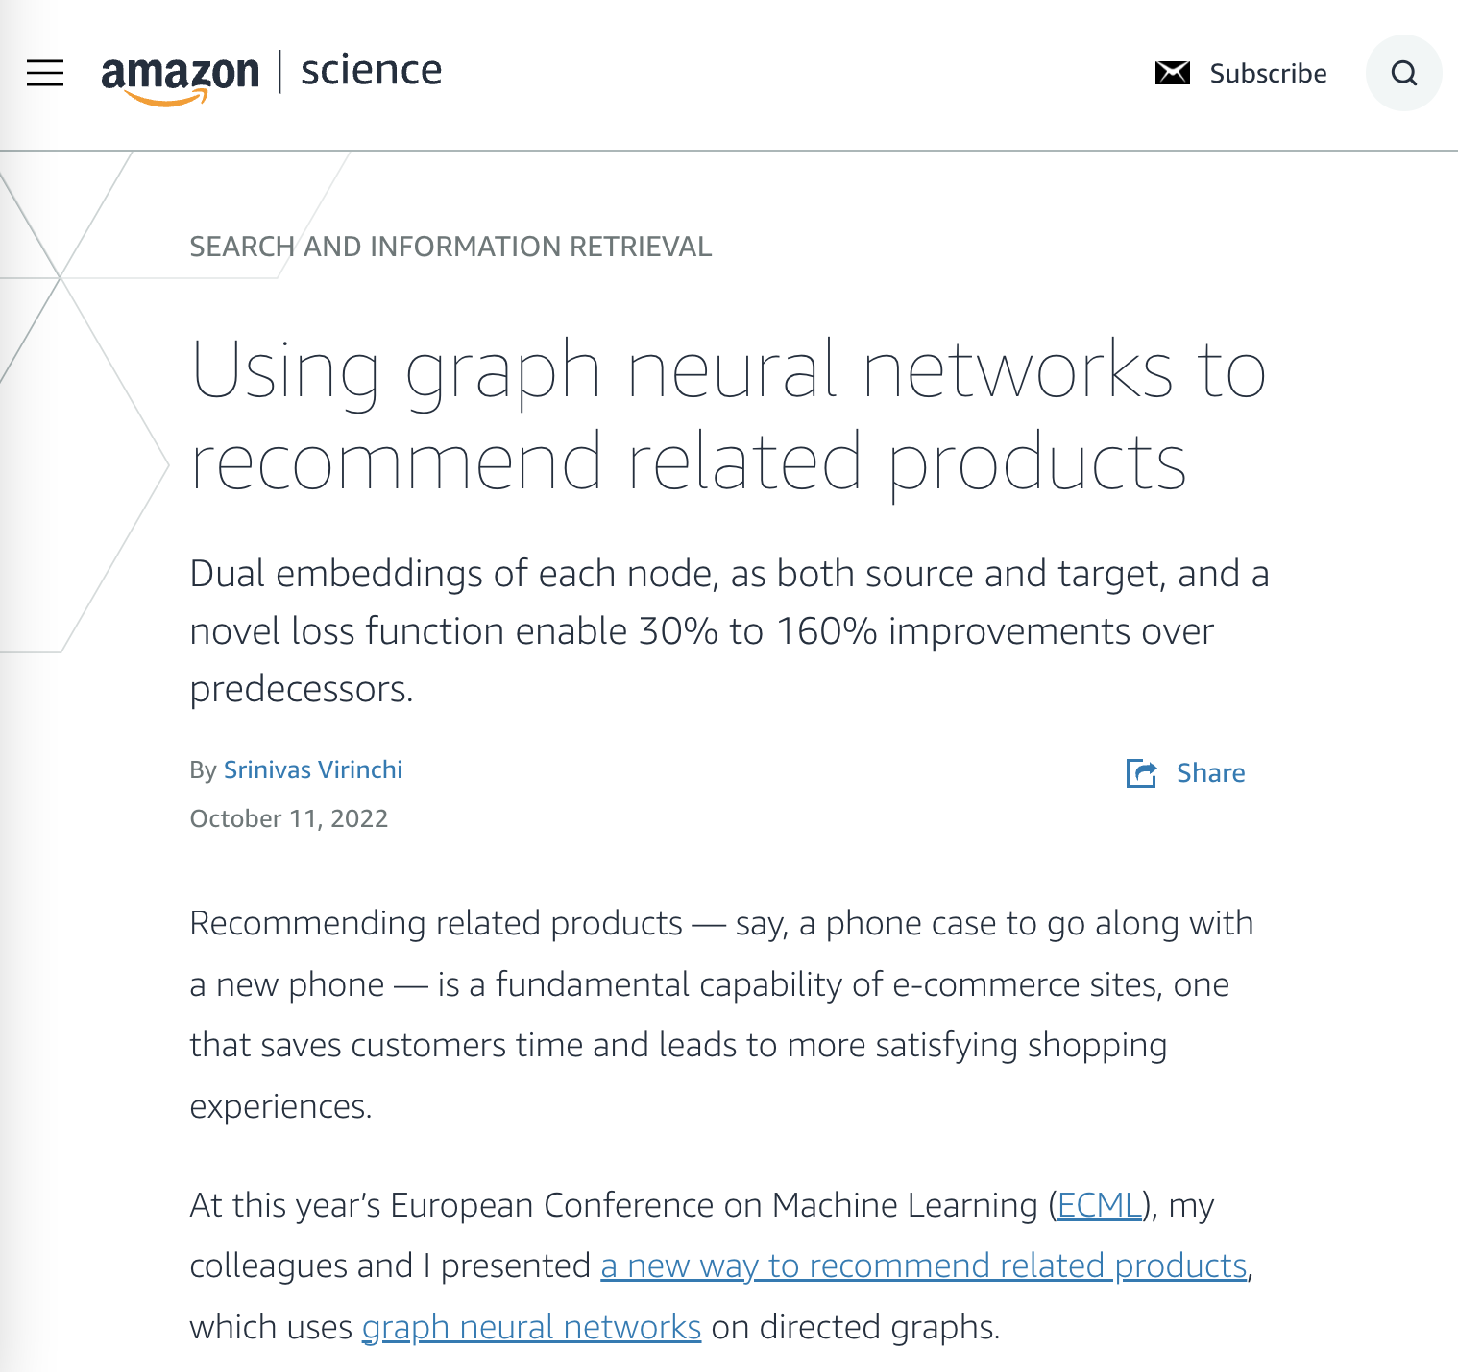
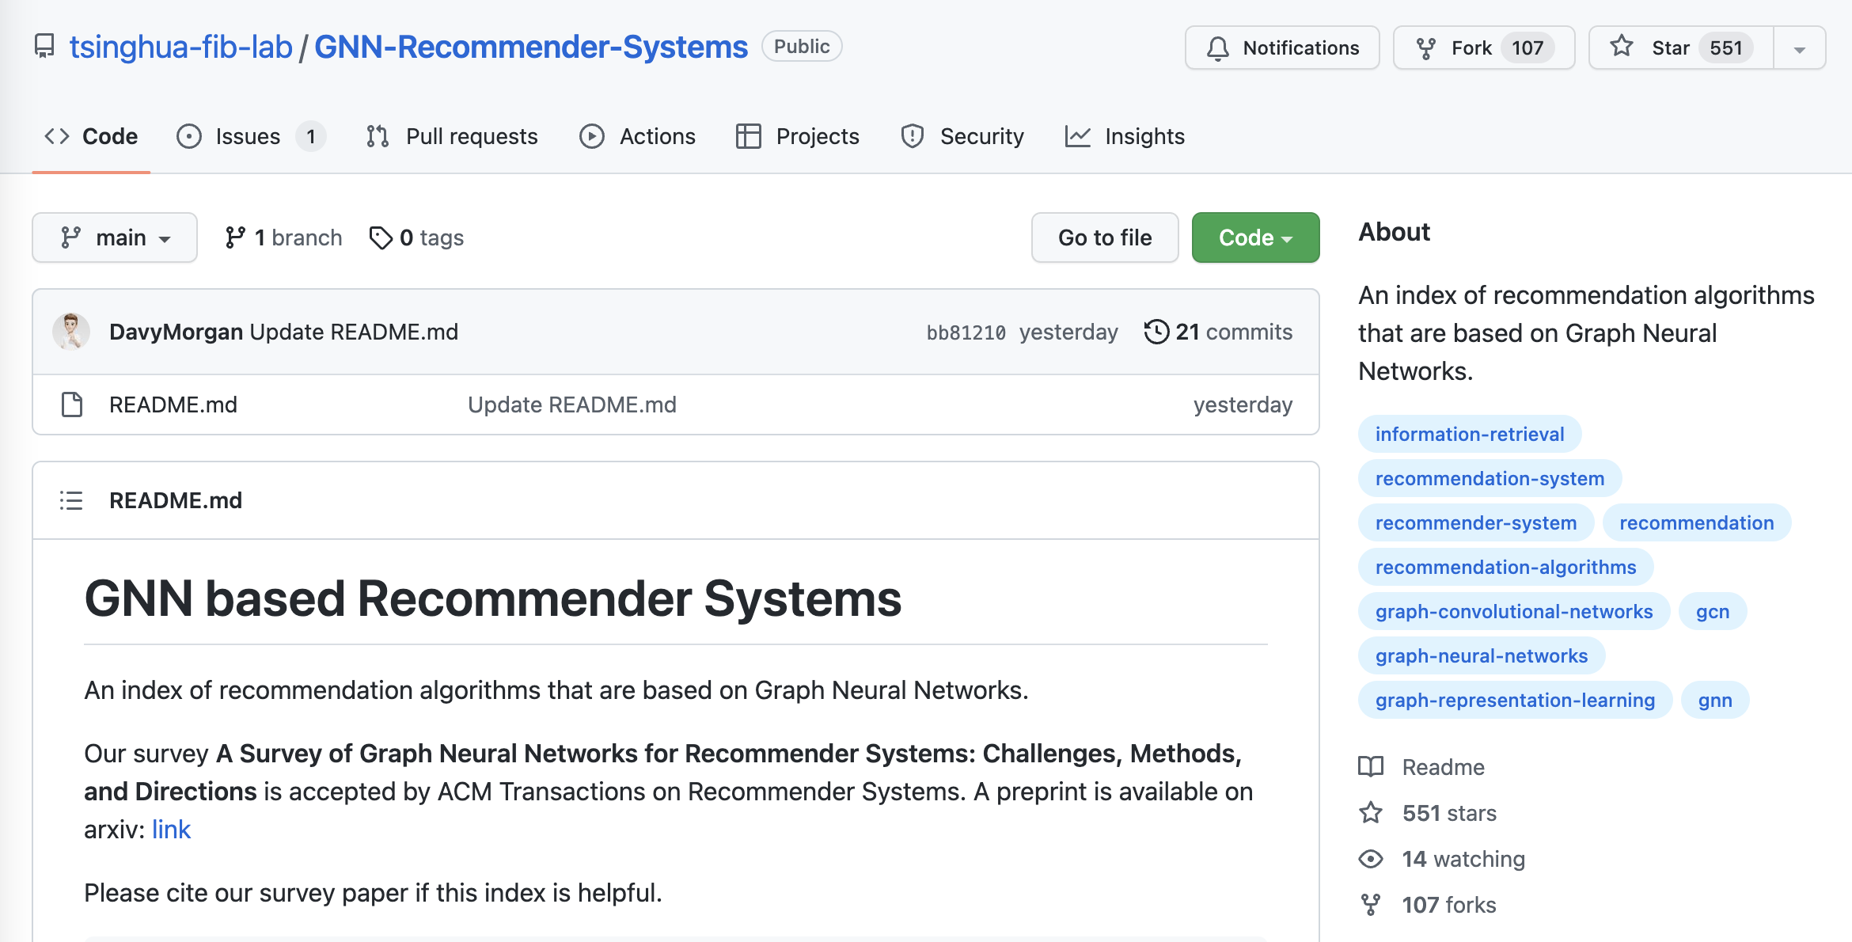
Why GNN?

Slide 21
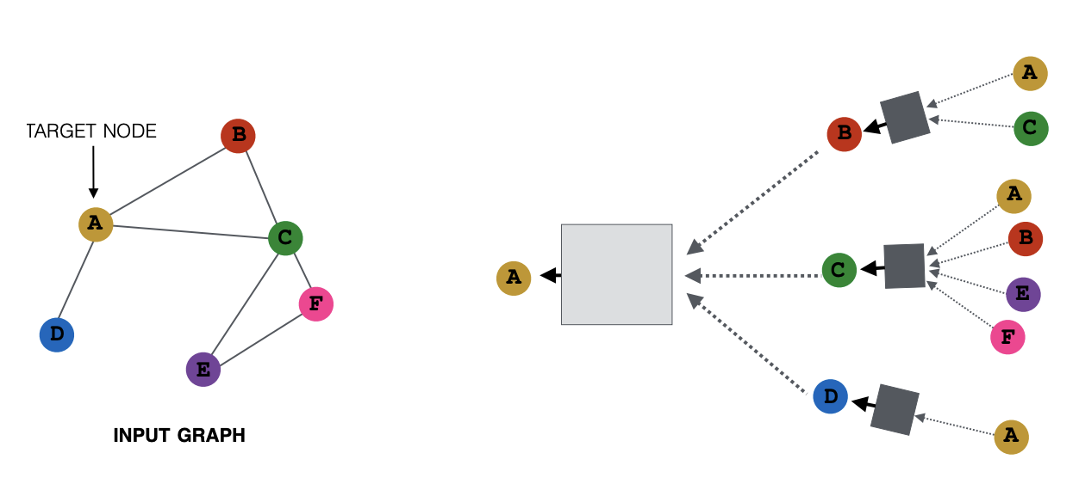

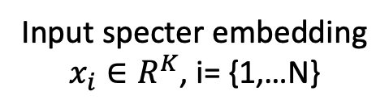

What is GNN?
Matrix Computation
Matrix Computation
Node (a paper): specter embedding
Edge: citation
Input specter embedding
$x_{i}∈R^{K}$, i= {1,…N}
Output embedding
$$x_{A}∈R^{f}$$
2-hop
Input Citation Graph
$G∈R^{N×N}$
1-hop
Ref: https://snap-stanford.github.io/cs224w-notes/machine-learning-with-networks/graph-neural-networks

Slide 22
Challenge Scale Data Parallelism v.s. Gsplit Parallelism
Proposed
Today’s data parallelism (e.g., DGL, PaGraph)
Proposed split parallelism (Gsplit)
Standard
Data parallelism – too much communication
Split parallelism (Proposed)

Slide 23
Gsplit is Faster
Today’s data parallelism (e.g., DGL, PaGraph)
Proposed split parallelism (Gsplit)

Slide 24
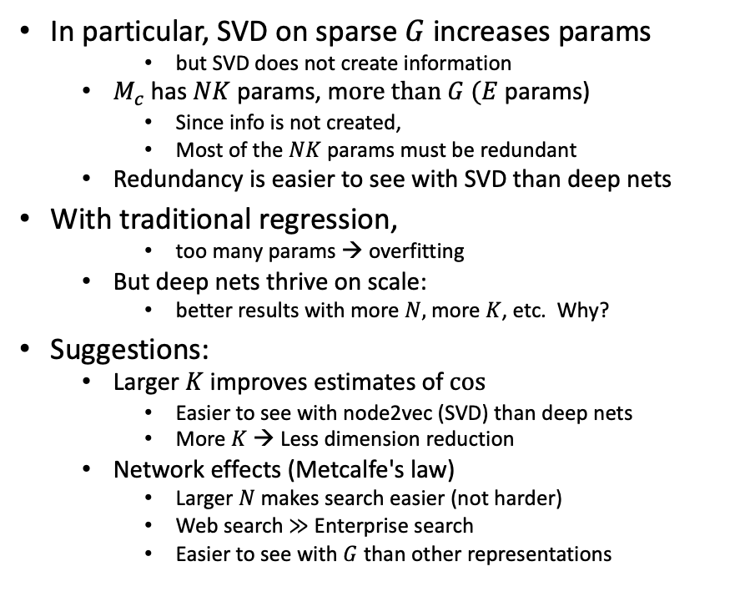
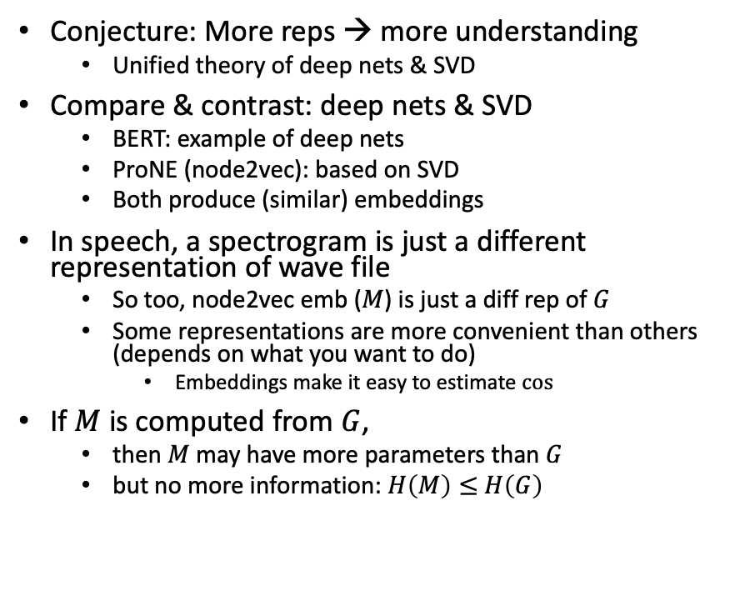
Bigger Stretch: Theoretical combinations of deep nets & SVD
Conjecture: More reps → more understanding
Unified theory of deep nets & SVD
Compare & contrast: deep nets & SVD
BERT: example of deep nets
ProNE (node2vec): based on SVD
Both produce (similar) embeddings
In speech, a spectrogram is just a different representation of wave file
So too, node2vec emb ($M$) is just a diff rep of $G$
Some representations are more convenient than others (depends on what you want to do)
Embeddings make it easy to estimate $cos⁡⁡$
If $M$ is computed from $G$,
then $M$ may have more parameters than $G$
but no more information: $H\left(M\right)≤$ $H\left(G\right)$
In particular, SVD on sparse $G$increases params
but SVD does not create information
$M_{c}$has $NK$ params, m$ore than G$ $(E$params)
Since info is not created,
Most of the $NK$ params must be redundant
Redundancy is easier to see with SVD than deep nets
With traditional regression,
too many params → overfitting
But deep nets thrive on scale:
better results with more $N,$ more $K$, etc. Why?
Suggestions:
Larger $K$ improves estimates of $cos⁡$
Easier to see with node2vec (SVD) than deep nets
More $K$ → Less dimension reduction
Network effects (Metcalfe's law)
Larger $N$ makes search easier (not harder)
Web search $≫$ Enterprise search
Easier to see with $G$ than other representations

Slide 25
backup

Slide 26
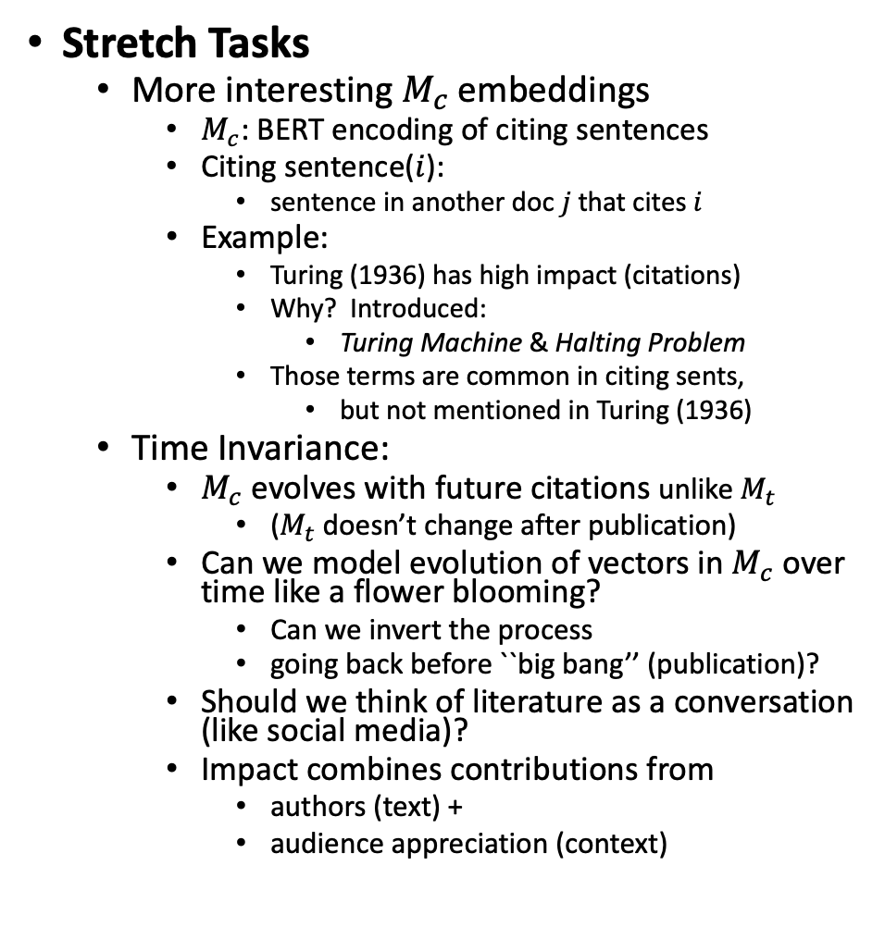
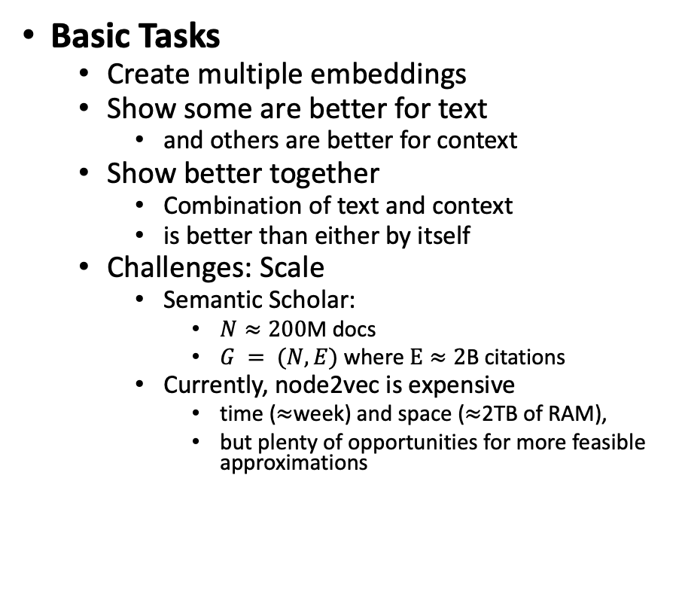
Basic & Stretch Tasks
Stretch Tasks
More interesting $M_{c}$embeddings
$M_{c}$: BERT encoding of citing sentences
Citing sentence($i$):
sentence in another doc $j$that cites $i$
Example:
Turing (1936) has high impact (citations)
Why? Introduced:
Turing Machine & Halting Problem
Those terms are common in citing sents,
but not mentioned in Turing (1936)
Time Invariance:
$M_{c}$ evolves with future citations unlike $M_{t}$
($M_{t}$doesn’t change after publication)
Can we model evolution of vectors in $M_{c}$ over time like a flower blooming?
Can we invert the process
going back before ``big bang’’ (publication)?
Should we think of literature as a conversation (like social media)?
Impact combines contributions from
authors (text) +
audience appreciation (context)
Basic Tasks
Create multiple embeddings
Show some are better for text
and others are better for context
Show better together
Combination of text and context
is better than either by itself
Challenges: Scale
Semantic Scholar:
$N≈200$M docs
$G = (N, E)$where $E≈2$B citations
Currently, node2vec is expensive
time ($≈$week) and space ($≈$2TB of RAM),
but plenty of opportunities for more feasible approximations
Anchor Text
Current status
(K=280)

Slide 27
SOTA-Chasing
Root causes for SOTA-chasing
Iffy reviewing
Lack of leadership
Iffy reviewing
Root cause: Bad assignments of submissions to reviewers
We used to do this by hand (better than we do these days)
Current status: Conference software (open review, softconf, easy chair) use iffy programs
Evaluation: Safe and effective (???)
Reviewers should be
More qualified (and sympathetic to background assumptions)
than target audience
If not, reviewers will ``abstain’’ (average grade or worse) → kill paper
Bad assignments
➔ Teach authors to write papers that can be reviewed by unqualified reviewers
➔ SOTA-chasing
➔ Lack of meaningful progress

